Slide 1
Teaching Challenges and How to Succeed
Managing challenging learners
Lyn Fry Oct 2023

Slide 2
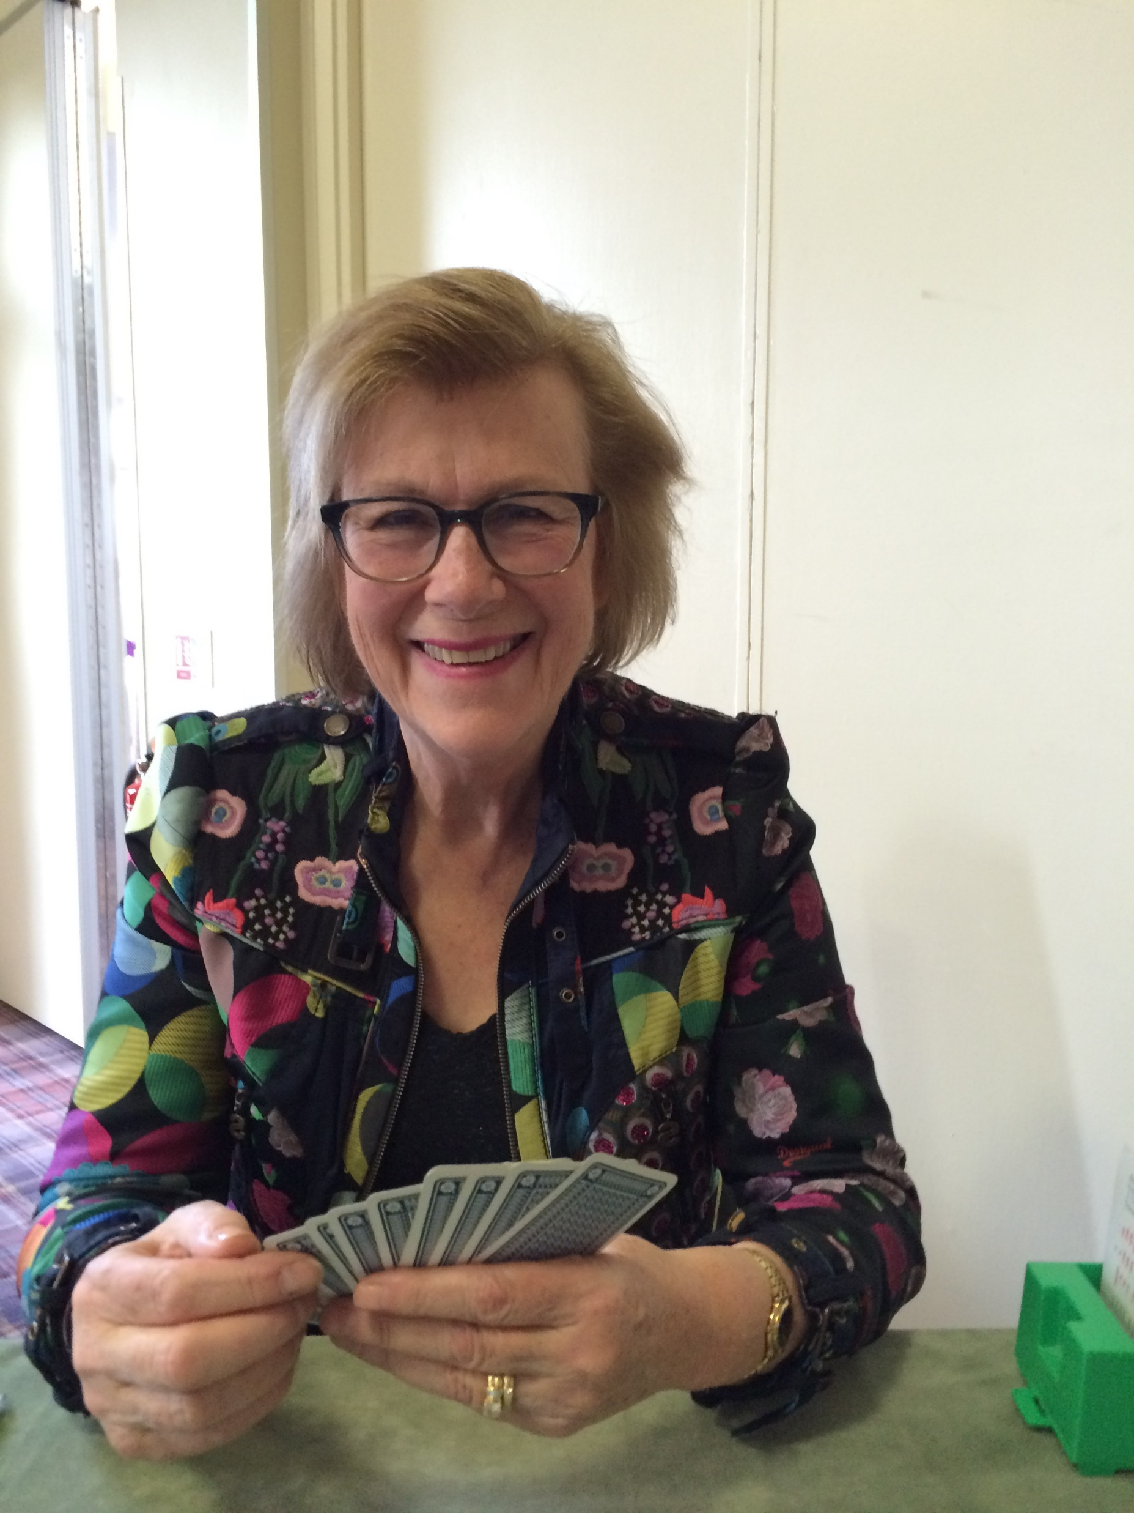
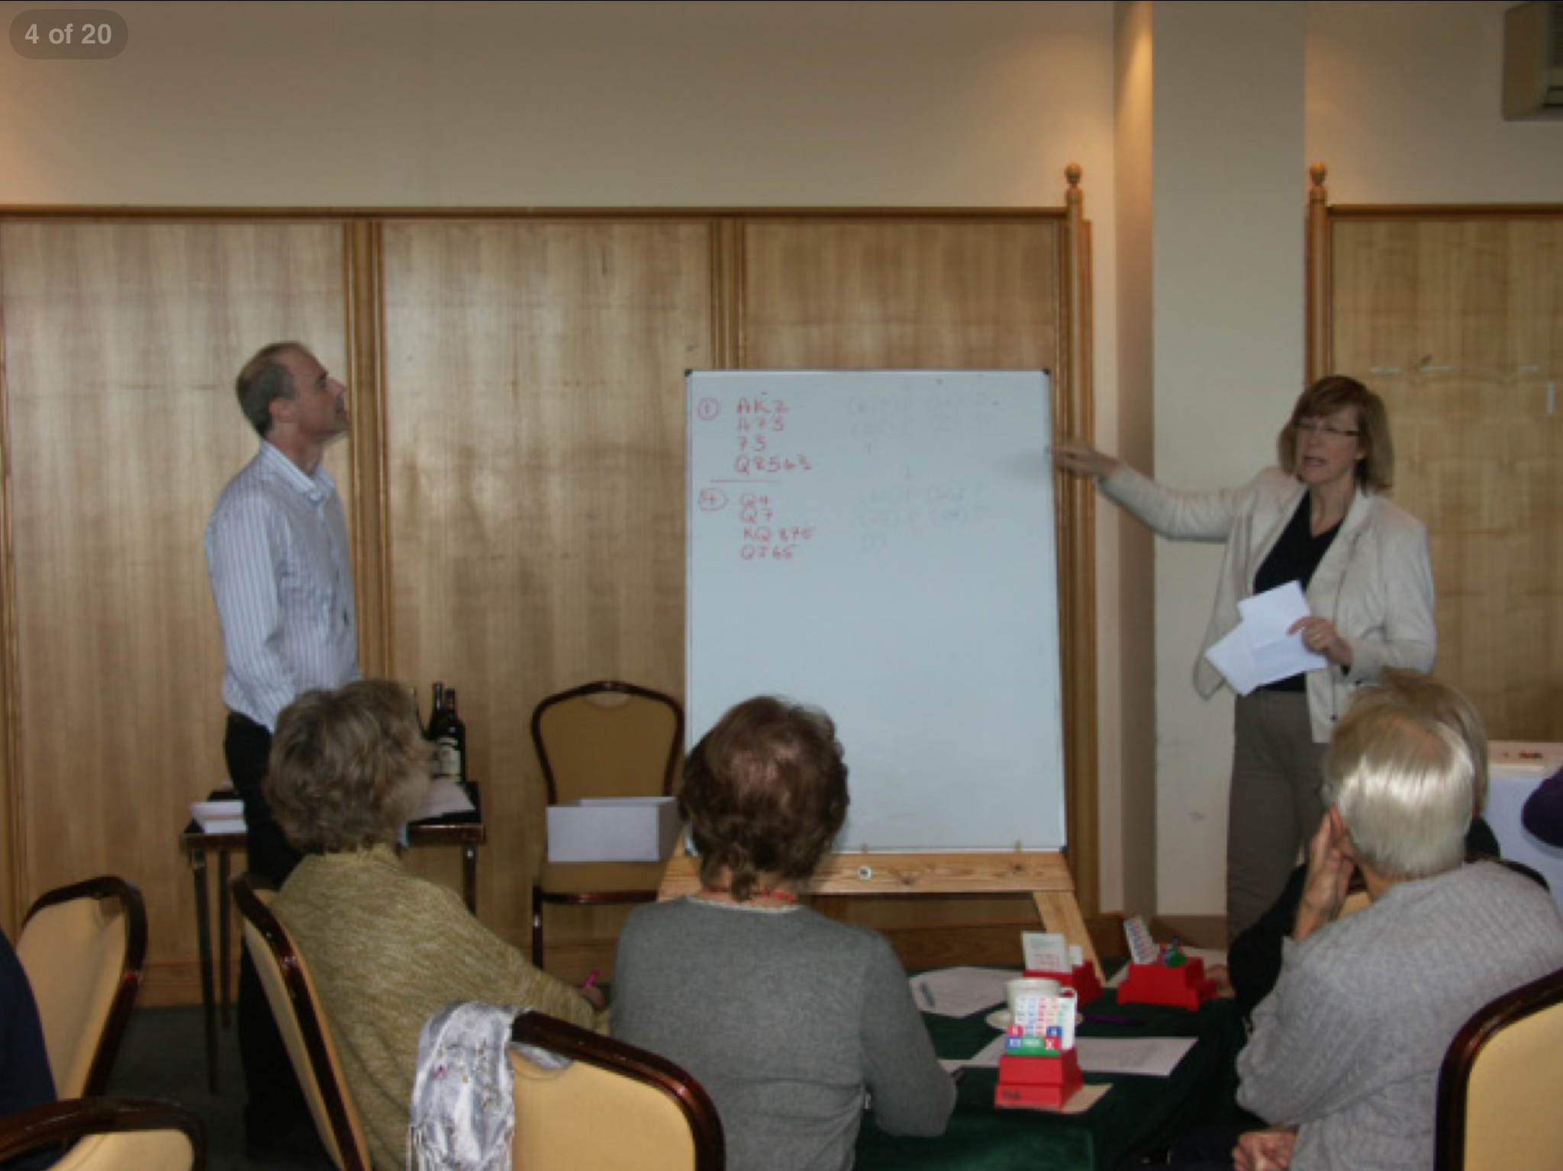

Slide 3
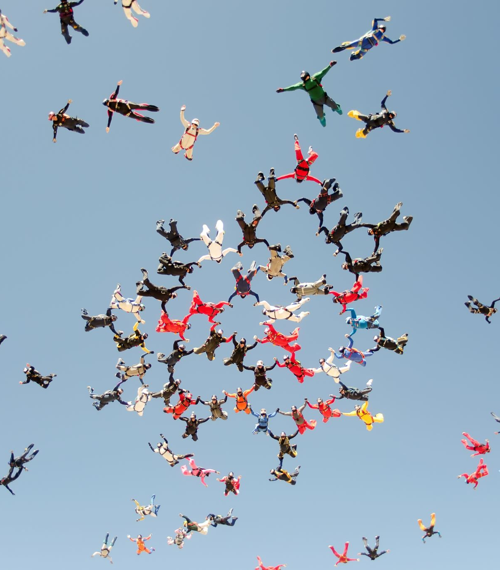
Overview
The characters
Your toolkit
Q & A

Slide 4
Latecomer
Always start right on time
Talk to them afterwards
Arrive early to chat and answer questions

Slide 5
The Shrinking Violet
Build confidence. Never criticise publicly
Sandwich approach
Handouts in advance
Become involved

Slide 6
The Bully
Seat apart from those he might persecute
Talk afterwards
Discuss Laws of Contract Bridge (Law 74)

Slide 7
The Know All
Seat away from shrinking violets
Make a joke
Talk afterwards

Slide 8
The Challenger
Offer opportunities to discuss in private, eg before the lesson
But my other teacher says

Slide 9
The Questioner
Form to be filled in; photo of the hand
Discuss interesting issues with the class

Slide 10
The Outcast
Let everyone have a turn playing with them
Encourage them to bring a partner of their own
Play with them yourself

Slide 11
The Audience Member
Ask others to play with them
Push them to sign up with gentle clubs or events
Play with them yourself
“Lesson junky”

Slide 12
The one who doesn’t get it
Think about her assets to the group, gently help them to focus

Slide 13
The whole class fails to get it!!:
Class failure = teaching failure
Lesson aims disconnect

Slide 14
Teaching approach
Errorless learning
Punishment
Special lessons
Discuss with another teacher

Slide 15
A few general rules
Welcome pupils by name and with a smile
Encourage them to bring hands to discuss
Rules to cover basic bridge errors
Keep the initial explanation short
Try to make people feel good all the time
Watch out for those who are nervous or lack confidence
Repeat lessons which are especially hard
Always have a handout
Give explanations individually if necessary
Ask pupils for suggestions about what they want taught
Move them into club bridge by organising tournaments, playing with them
Have a noticeboard kept up to date with information, jokes, hints, and stories
Relax after the lesson.

Slide 16
Questions and Answers

